Slide 1
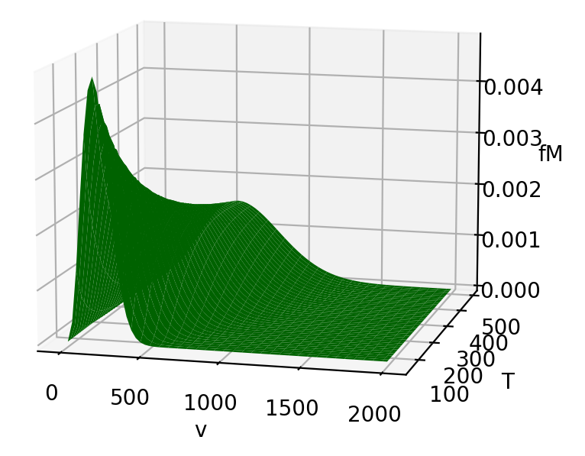
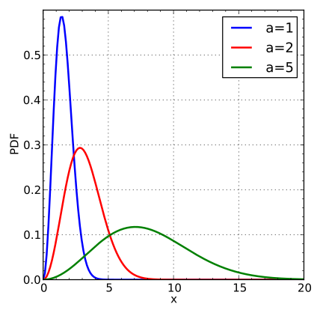

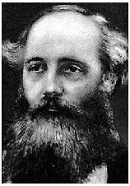
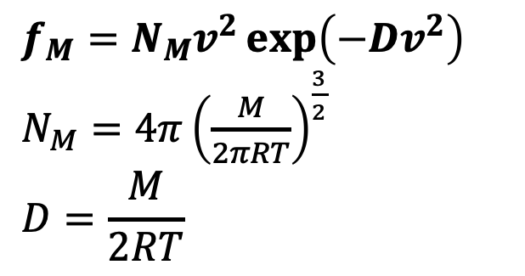

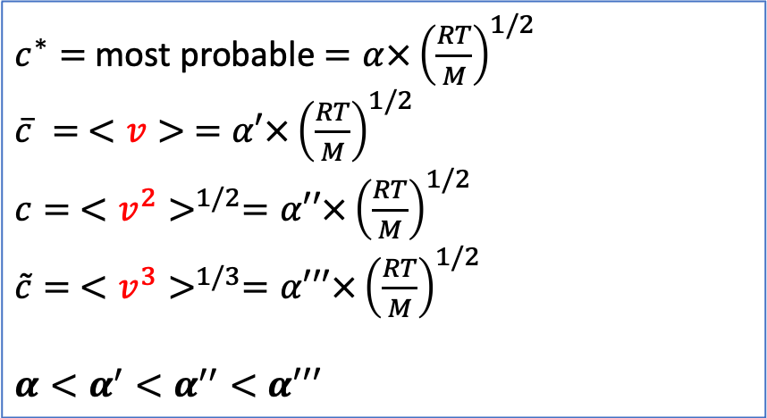

Recap: moments from the probability density functions
$$f_{M}=N_{M}v^{2}\exp\left(−Dv^{2}\right)$$
$N_{M}=4π{\left(\frac{M}{2πRT}\right)}^{\frac{3}{2}}$
$$D=\frac{M}{2RT}$$
$$f_{M}$$
$v$ (speed)
$c^{∗}=$ most probable $=α×{\left(\frac{RT}{M}\right)}^{1/2}$
$\overline{c} = <v> =α′×{\left(\frac{RT}{M}\right)}^{1/2}$
$c= <v^{2}>^{1/2}=α′′×{\left(\frac{RT}{M}\right)}^{1/2}$
$\tilde{c}= <v^{3}>^{1/3}=α′′′×{\left(\frac{RT}{M}\right)}^{1/2}$
$$α<α^{′}<α^{′′}<α′′′$$

Slide 2
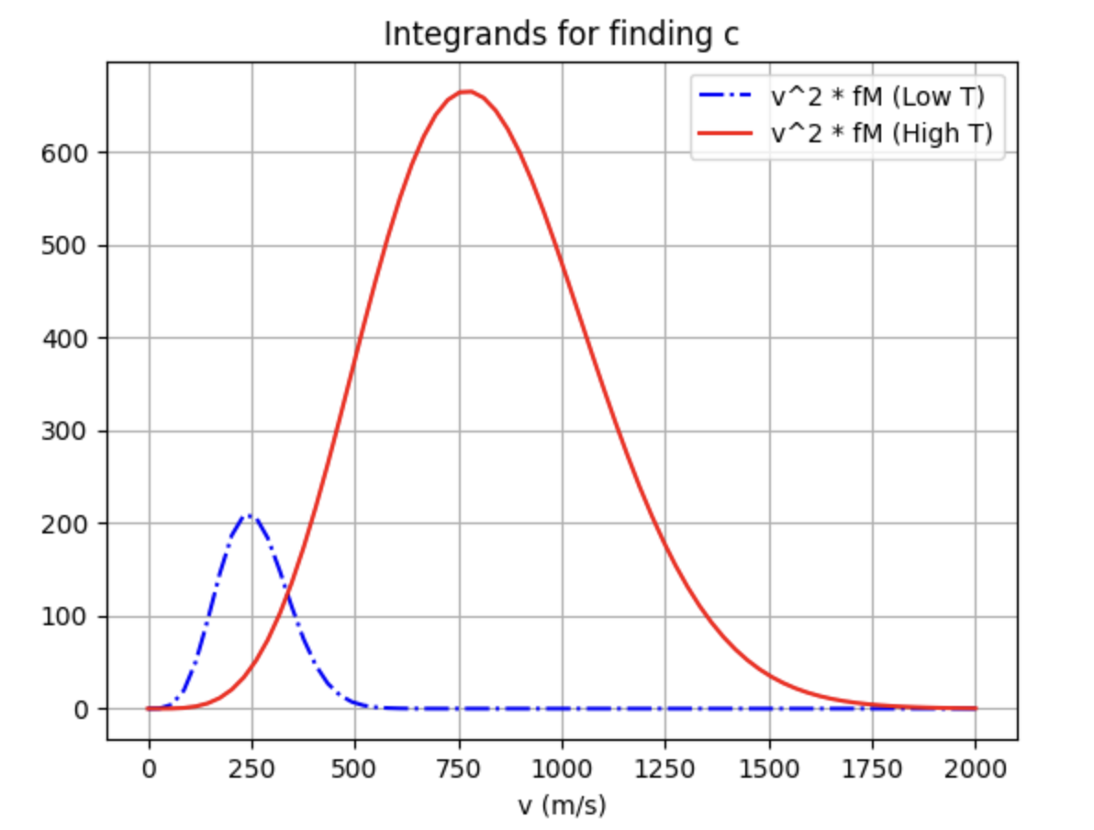
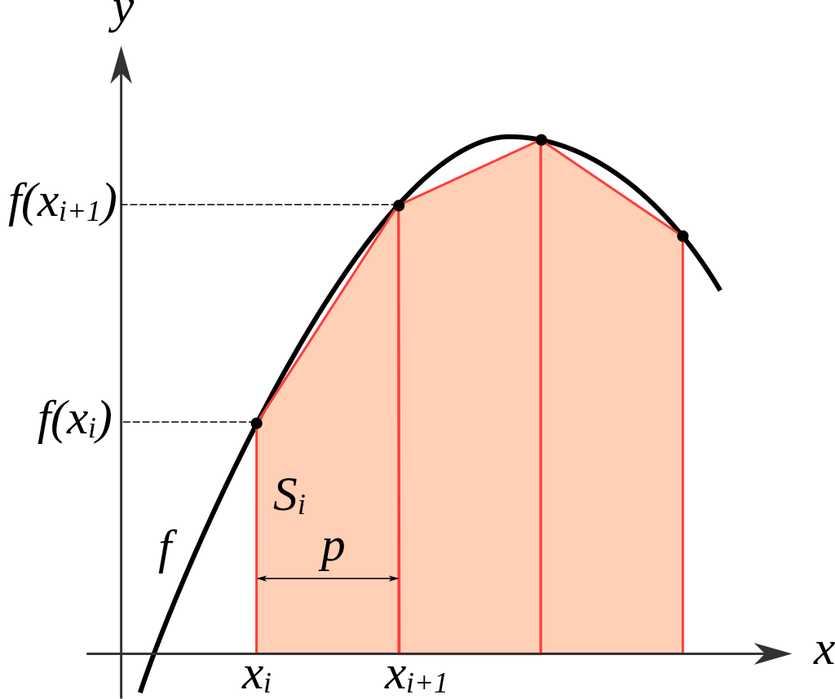
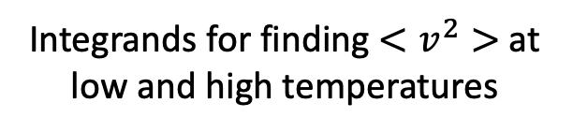
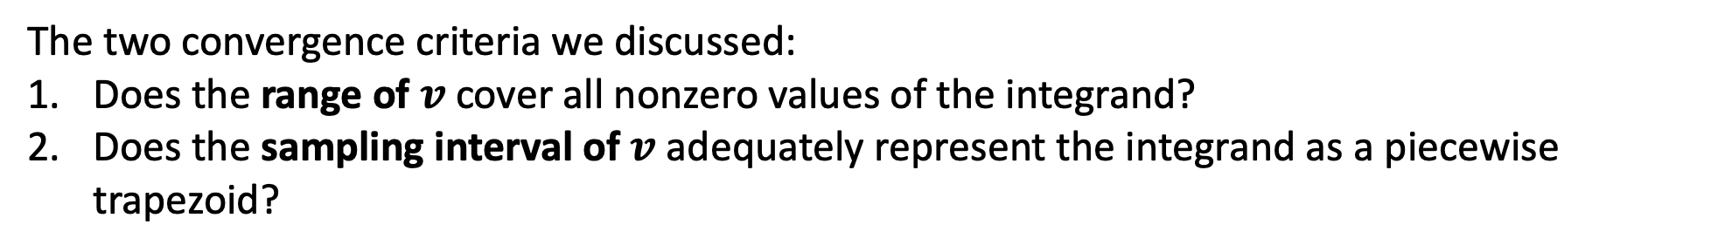
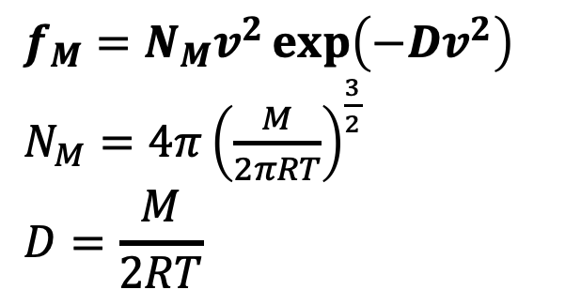
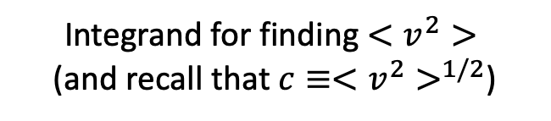
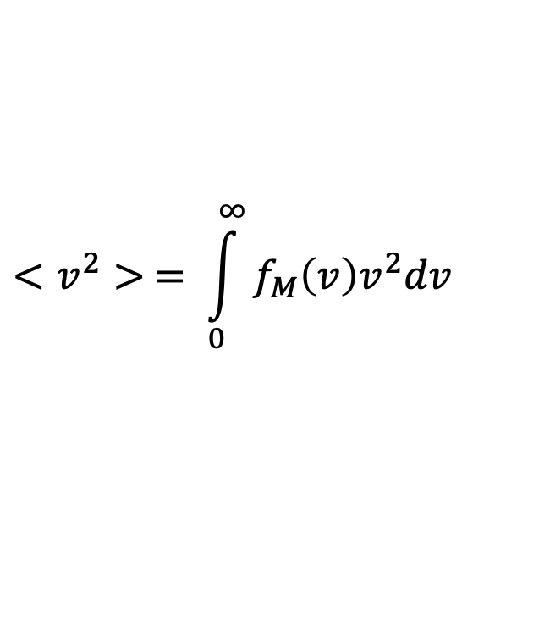
Recap: convergence of numerical methods
Integrands for finding $<v^{2}>$at low and high temperatures
$$f_{M}=N_{M}v^{2}\exp\left(−Dv^{2}\right)$$
$N_{M}=4π{\left(\frac{M}{2πRT}\right)}^{\frac{3}{2}}$
$$D=\frac{M}{2RT}$$
The trapezoidal rule
$$<v^{2}> = \int_{0}^{∞}{f_{M}\left(v\right)v^{2}dv}$$
Integrand for finding $<v^{2}>$
(and recall that $c≡<v^{2}>^{1/2}$)
The two convergence criteria we discussed:
Does the range of $v$ cover all nonzero values of the integrand?
Does the sampling interval of $v$ adequately represent the integrand as a piecewise trapezoid?

Slide 3
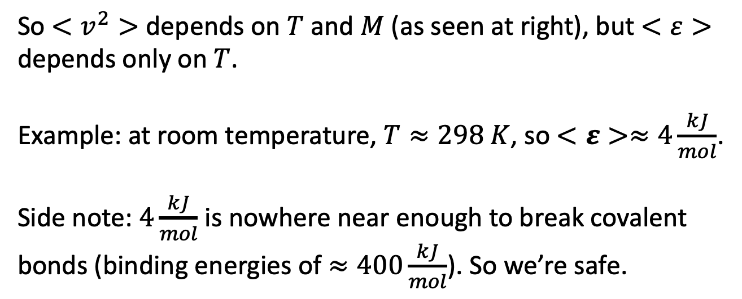

Recap: average kinetic energy depends only on the temperature (not the mass)
We saw that $<v^{2}> =\frac{3RT}{M}$, while the average kinetic energy of a mole of gas molecules is
$$<ε>{=N}_{A}<\frac{1}{2}mv^{2}> =\frac{1}{2}M\frac{3RT}{M}=\frac{3}{2}RT$$
So $<v^{2}>$ depends on $T$ and $M$ (as seen at right), but $<ε>$ depends only on $T$.
Example: at room temperature, $T≈298 K$, so $<ε>≈4\frac{kJ}{mol}$.
Side note: $4\frac{kJ}{mol}$ is nowhere near enough to break covalent bonds (binding energies of $≈400\frac{kJ}{mol}$). So we’re safe.

